Slide 1
Signals and Communication Systems (SCS)
Session-1

Slide 2
Objectives of the course
The main objective of this course is to provide students with a comprehensive treatment of the important issues in
understanding,
formulation and
analyzing
‘Signals and Communication Systems’ concepts and algorithms

Slide 3
Introduction to Signals
Topics to be covered:
Introduction to Signals, Systems and Signal Processing / communication system.
Classification of signals.
Elementary Continuous Time (CT) signals.
Singularity functions and their properties
Operations and manipulation of signals.

Slide 4
What is a ‘Signal’?
A Signal may be defined as a physical quantity that varies with respect to time, space or any other independent variable.
Examples:
Speech (telephony, radio, everyday communication)
Biomedical signals (ECG, EEG brain signals).
Sound and music.
Video and image.
Radar signals (range and bearing).
Temparature, Speed of a vehicle etc.

Slide 5

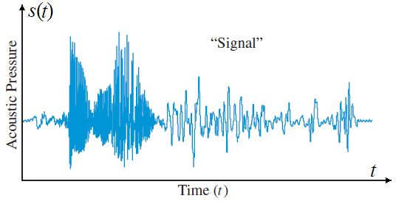
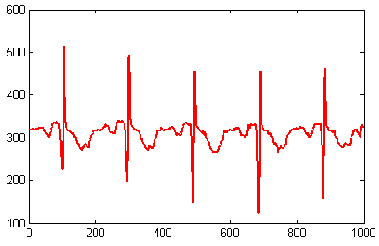
What is a ‘Signal’? …
Speech Signal
ECG Signal

Slide 6
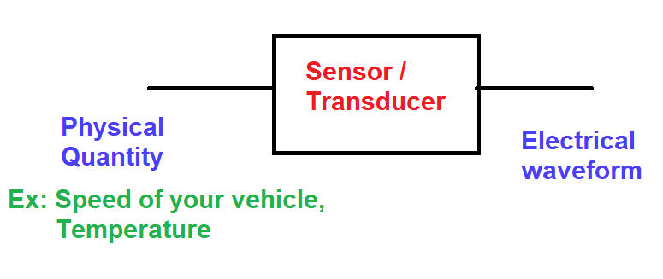
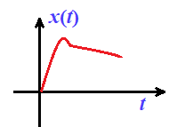
Generation of an electrical signal

Slide 7
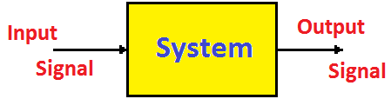
What is a ‘System’?
A System may be defined as a physical device that operates on a signal.
Examples:
PA System (Public Address System)
Digital Computer
Mobile Phone

Slide 8




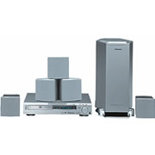



What is DSP Used For?
…And much more!

Slide 9
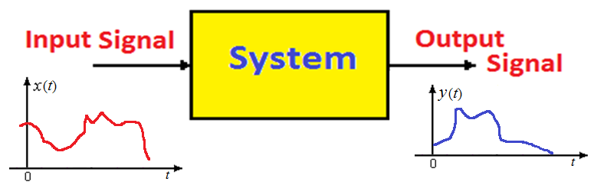
Relation between Signal and System
Signal: Physical quantity
System: Physical device
The input signal is modified according to the characteristics of the system and produce some output signal.

Slide 10
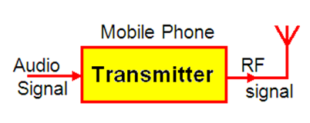
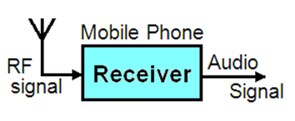
System…

Slide 11
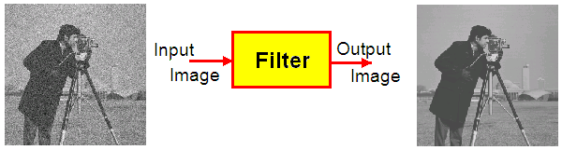
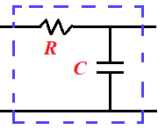
Signal processing?
Signals are carriers of some information
  Useful and unwanted
  Extracting, enhancing, storing and transmitting the useful information.

Slide 12
Classification of signals

Slide 13
Deterministic versus Random Signals
Any signal that can be uniquely described by an explicitly mathematical expression, a table of data or a well-defined rule is called deterministic signal.
Radio, Television, Mobile, the output of a noise generator and seismic signals are examples of Random signals.

Slide 14
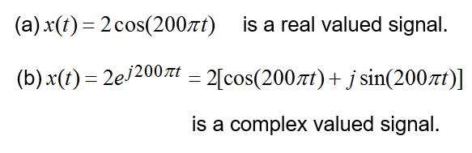
Real and Complex Signals
A signal x(t) is real signal if its value is a real number and a complex signal if its value is a complex number
Vector Signals:

Slide 15
Signals and Communication Systems (SCS)
Session-2

Slide 16
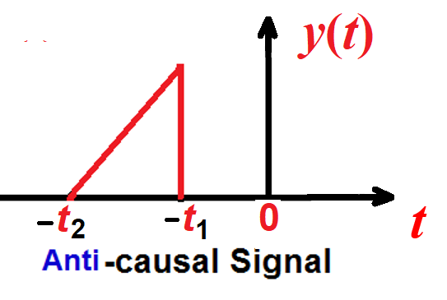
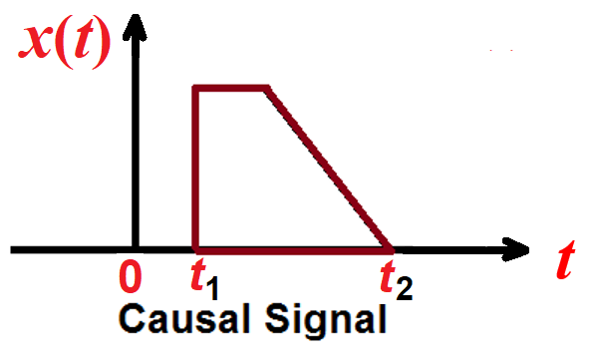
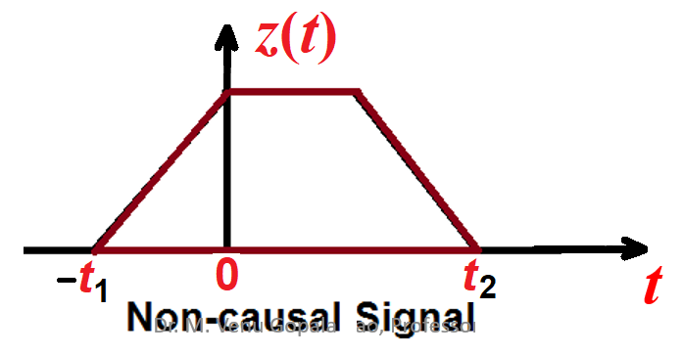
Causal and non-causal signals
A causal signal is defined as the signal having the values for t > 0, otherwise non causal signals. All right sided signals are referred to as causal signals.

Slide 17
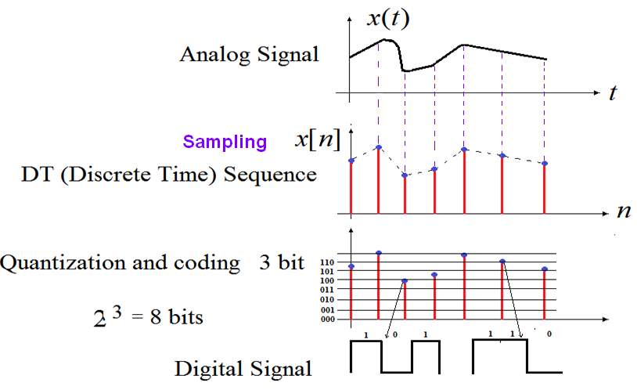
Analog, Discrete Time and Digital Signals

Slide 18
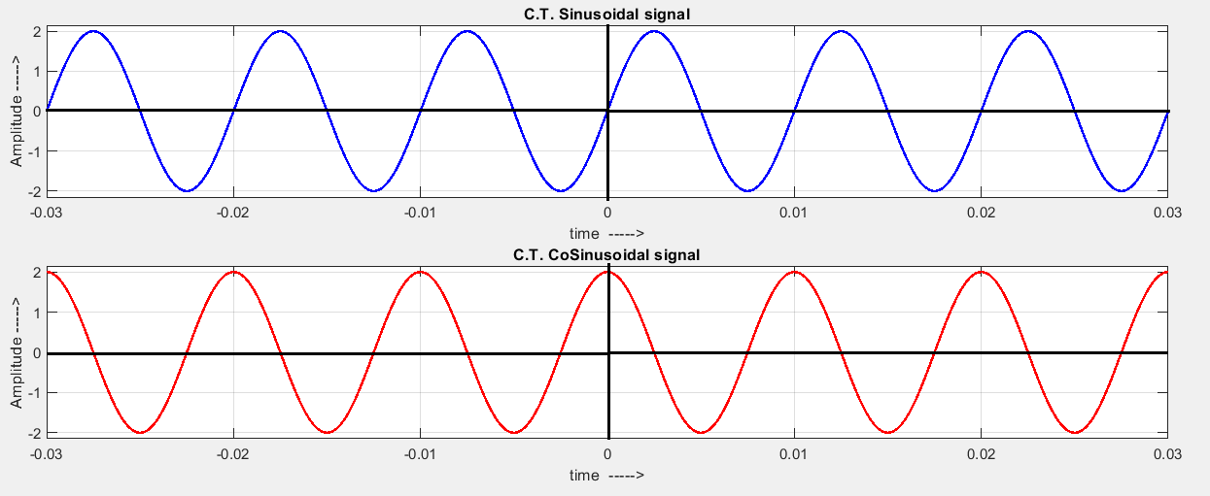
Periodic versus Non-Periodic Signals
A signal x(t) is said to be periodic if the equation
where n is an integer
for all ‘t ’ is satisfied.

Slide 19
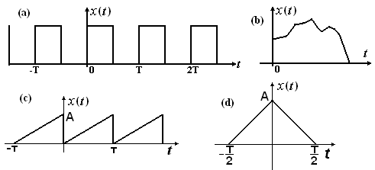
Periodic versus Non-Periodic Signals

Slide 20
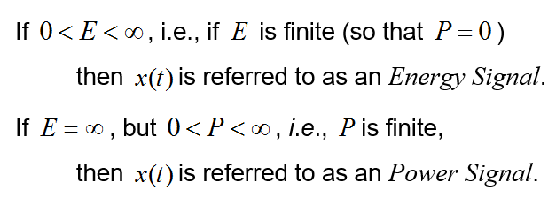
Energy and Power Signals
The normalized energy content ‘E’ of a signal x(t) is defined as
The normalized average power ‘P’ of a signal is defined as

Slide 21
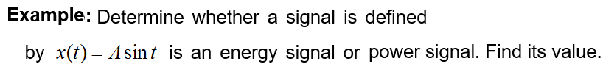

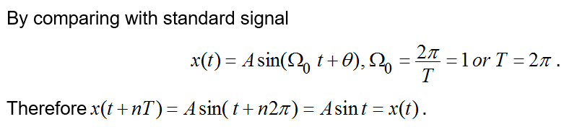
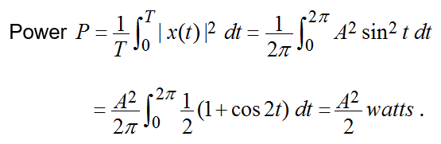

Slide 22
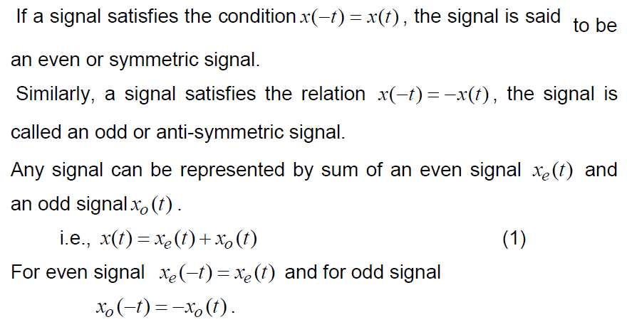
Even (or Symmetric) and Odd (anti-symmetric) signals

Slide 23
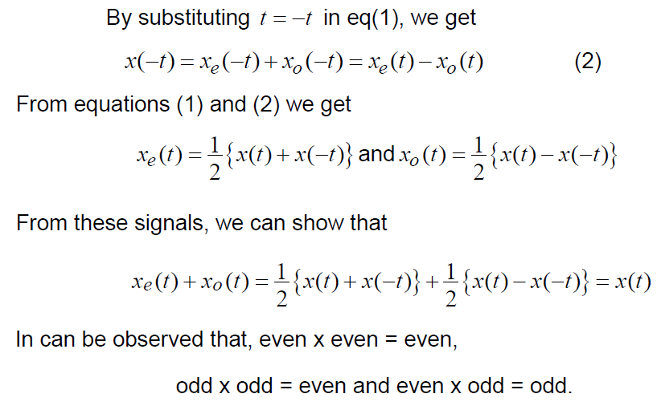

Slide 24
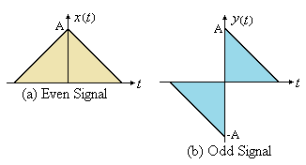

Example

Slide 25
End

